Slide 1


Movie Reservation System
Class : B4
Team Name :SnowWhite
Team Members : ChenYang WangJingru SunRuitong CaiSiyuan

Slide 2
CONTENT
Basic overview of the project
Project construction
1
2
项目基本概述
项目建设情况
Demonstration of project results
Deficiencies in the project
3
4
项目成果展示
项目存在不足

Slide 3
PART 01
Basic overview of the project
项目基本概述

Slide 4

Basic overview of the project
JAVA
This project mainly uses NetBeans IDE 8.2, Jdk1.8 and MySQL database to design.
The operation of ticket purchasing is simple and clear, and the interface design is beautiful and generous.
MOVIE

Slide 5

Basic overview of the project
JAVA
In order to solve the problem of buying tickets, we can complete it through computer and Internet. This system is developed and designed according to this requirement. We develop a secure and stable online movie ticket booking system to meet the needs of users and provide users with convenient services.

Slide 6

Basic overview of the project
SnowWhite
JAVA
Users can register or login, modify passwords, inquire about movie information, balance recharge, inquire about the number of cinemas, seat purchase tickets and other operations.

Slide 7
PART 02
Project construction
项目建设情况

Slide 8



Project construction
Discussion
Embark on
Modify
Summary
Look up the data together and divide up the work.
Summarize the project and what it brings us
Work together on projects
Correcting shortcomings

Slide 9

Project construction
Team spirit:
unite and help each other, dare to be the first.

Slide 10
Project construction
after entering the home page, if necessary, visitors can register for the operation of users of this website, after becoming users of the website, in addition to viewing the relevant cinema information and movie tickets, You can also buy multiple movie tickets online.

Slide 11
PART 03
Demonstration of project results
项目成果展示

Slide 12
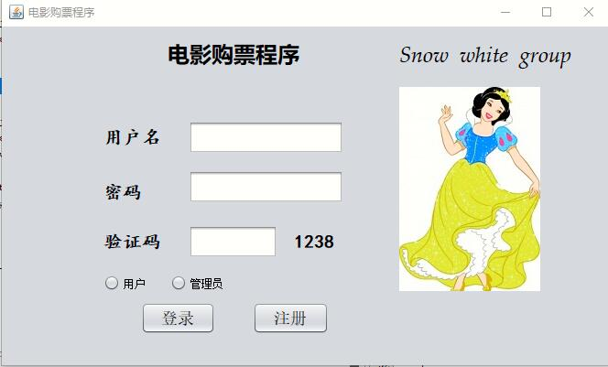
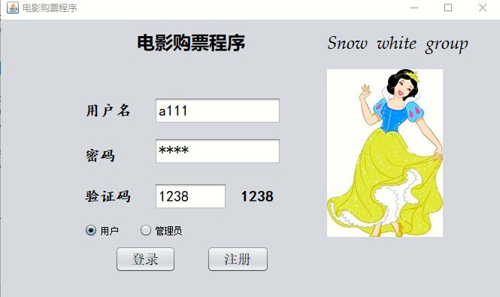
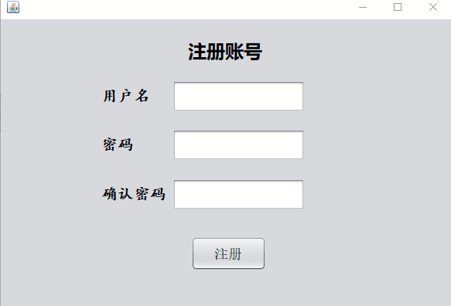
Demonstration of project results
Registration and login

Slide 13
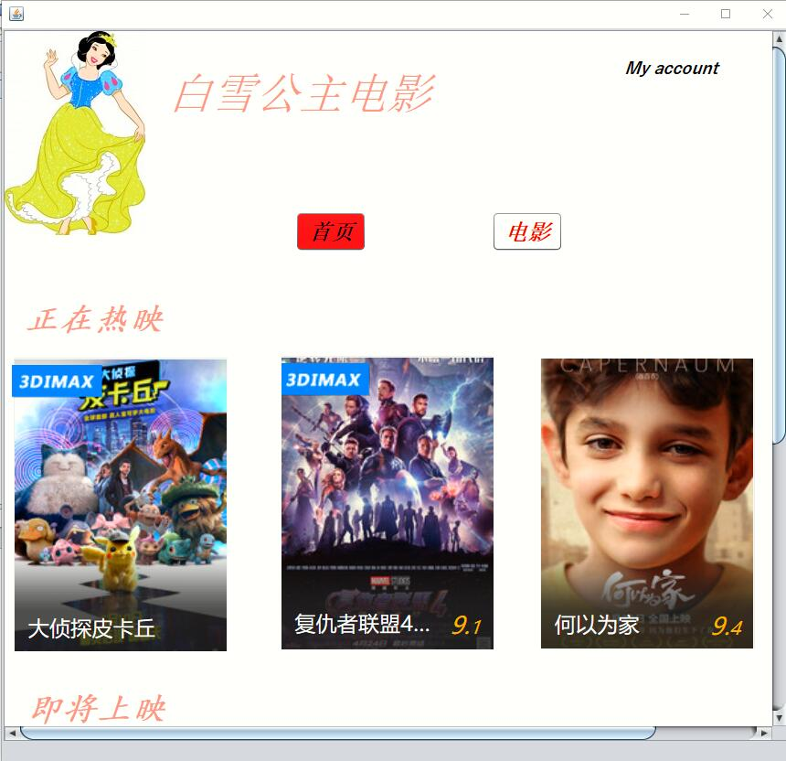
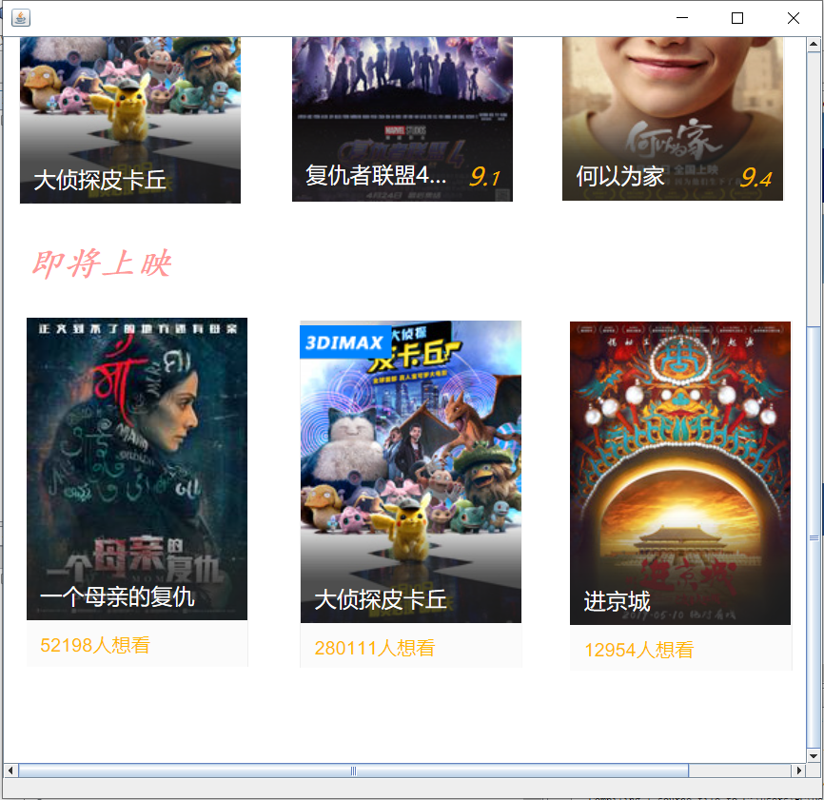
Demonstration of project results
Scroll through the home page

Slide 14
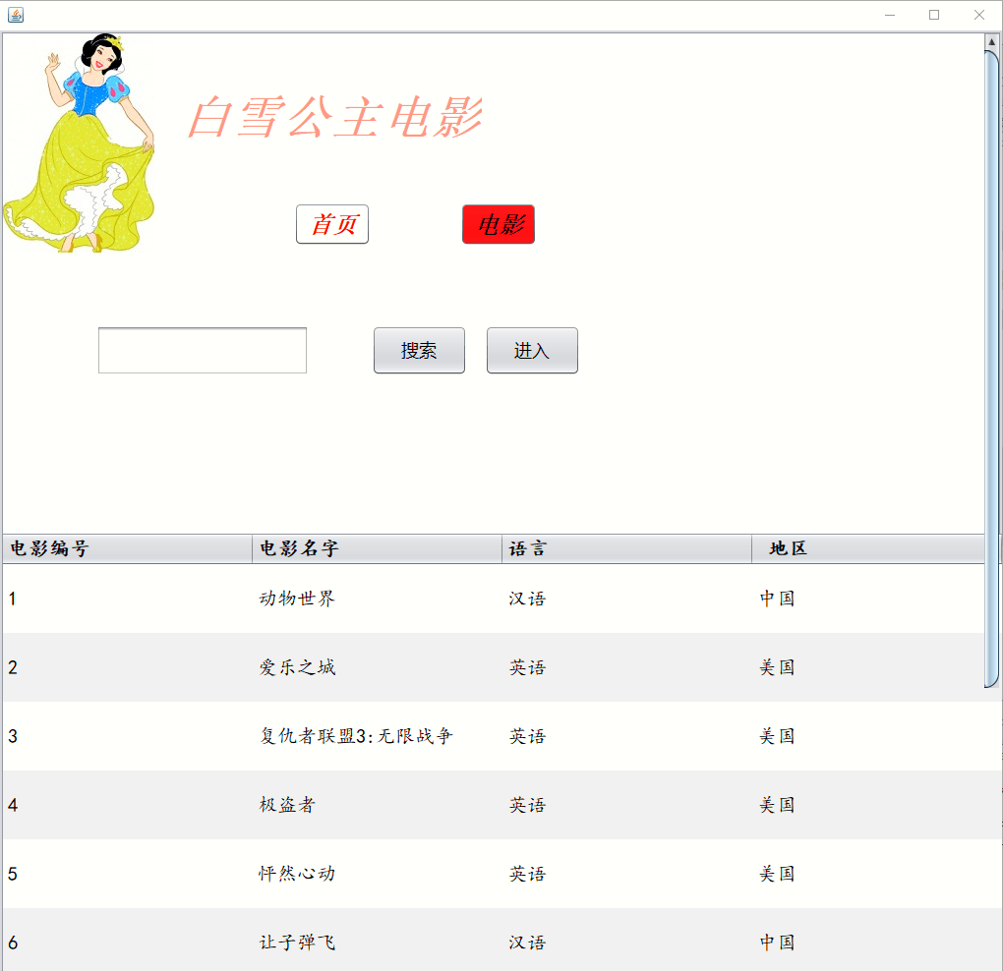
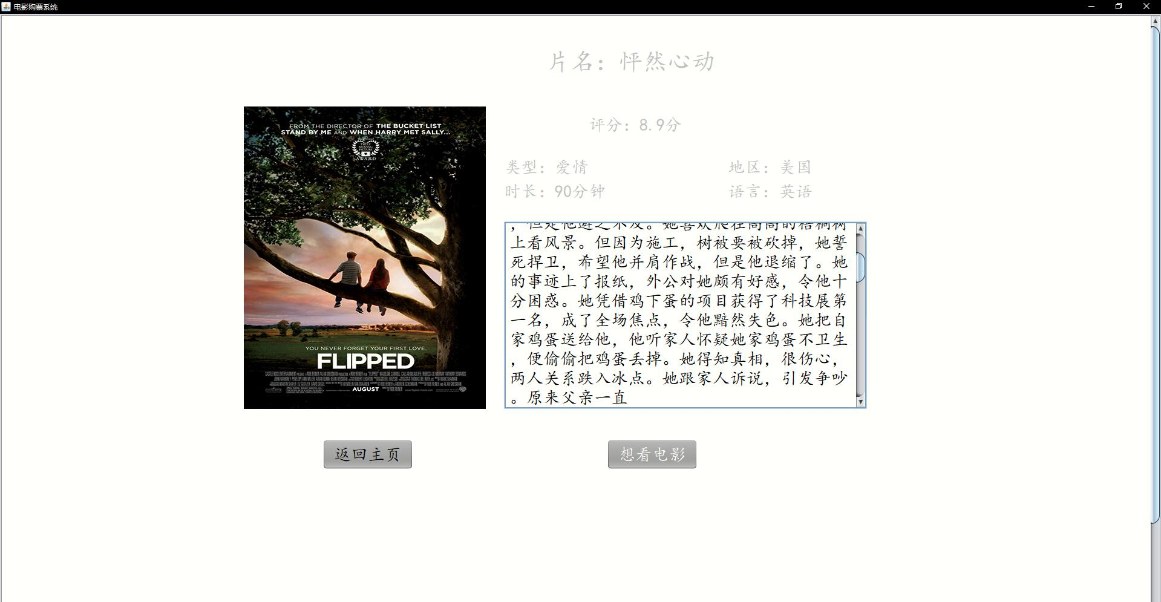
Demonstration of project results
Search for movies and view movie profiles

Slide 15
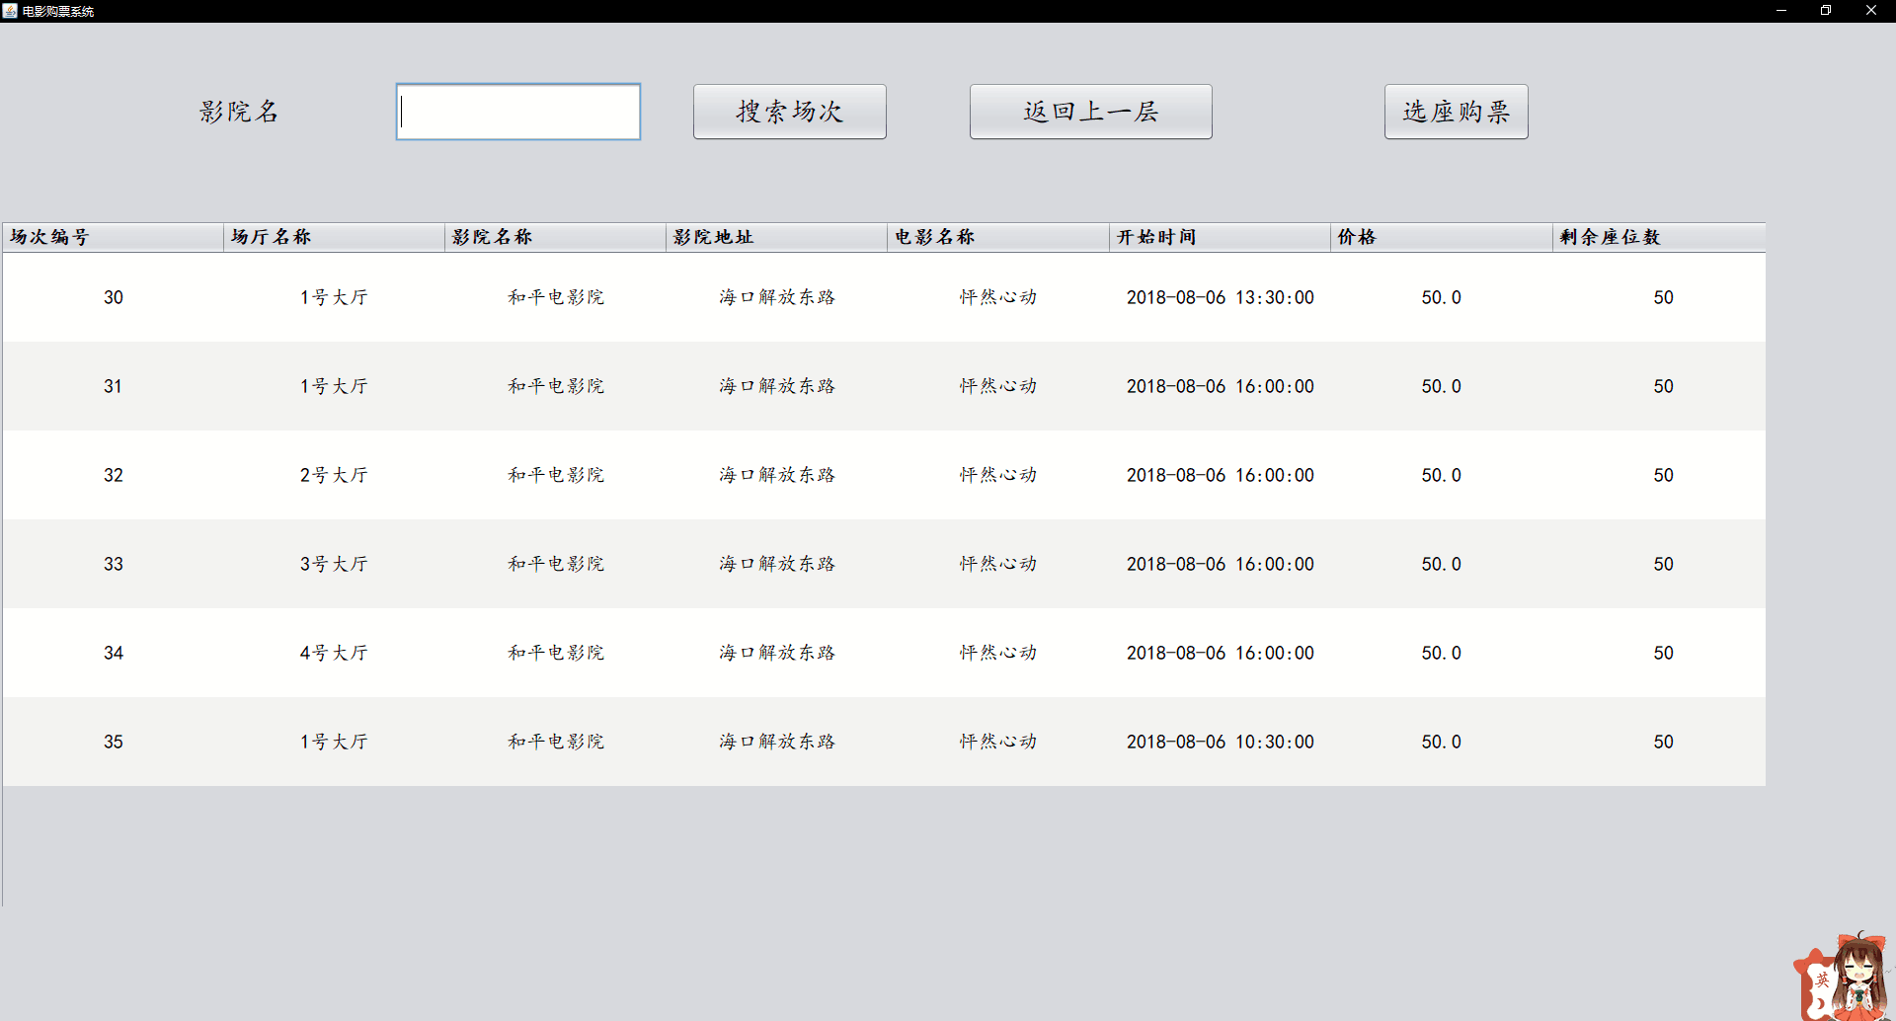
Demonstration of project results
Choose cinemas and movie number for tickets

Slide 16
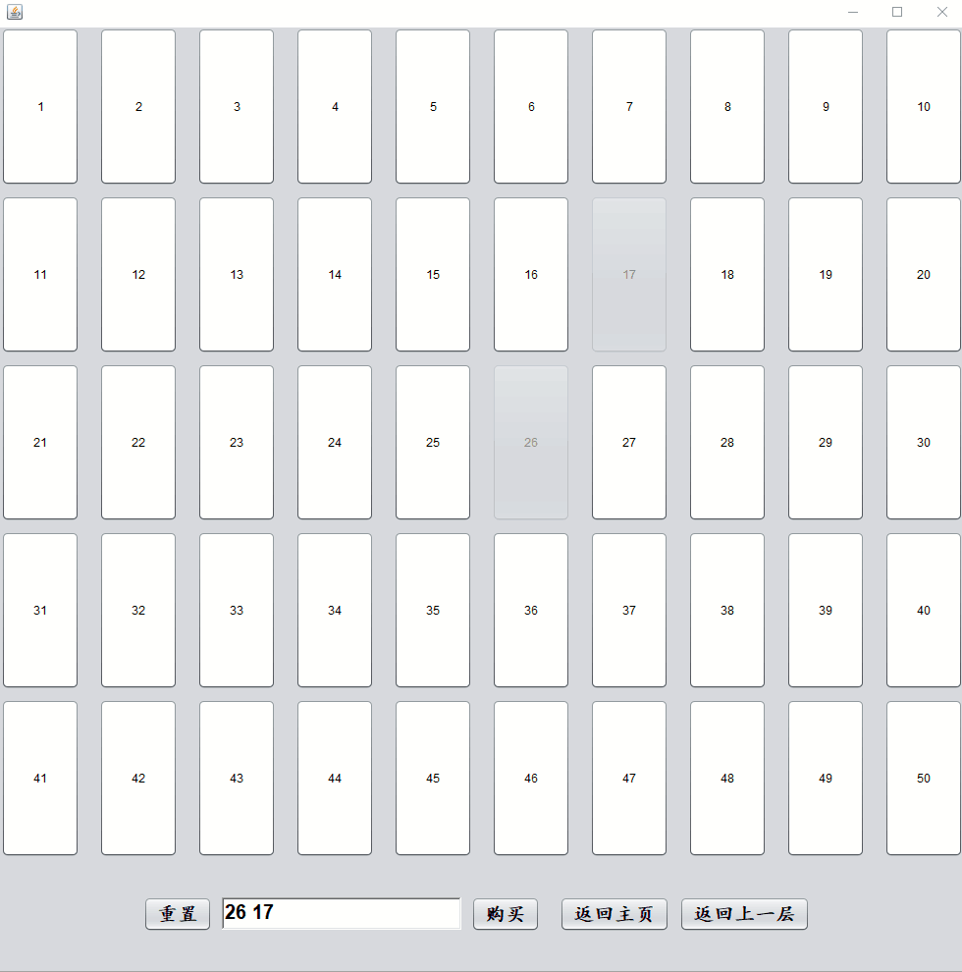
Demonstration of project results
Seat selection and buy tickets

Slide 17
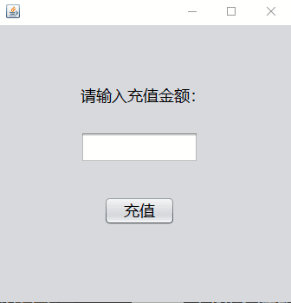
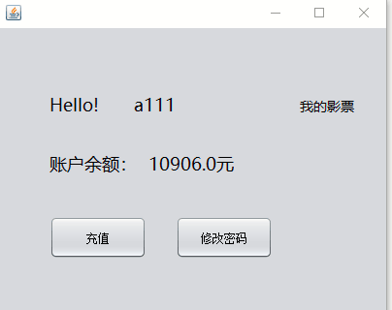
Demonstration of project results
Query and recharge balances

Slide 18
PART 04
Deficiencies in the project
项目存在不足

Slide 19
Deficiencies in the project
01
The interface is not beautiful enough
02
Not fully functional 。
03
The code is not concise enough
04
No more time to do the administrator interface
05
We need to learn more knowledge.
06
More creativity is needed

Slide 20
Thank you
—— SnowWhite

